Slide 1
Sentiment Analysis Project
This project used Lbibary classification 0 , 1
To analyze people feeling and emotions
The Data based on IMBD Data Set Films

Slide 2
Part1
First we need the data
Reprocessing the data and Cleaning it
Data → preprocessing -> logistic regression model
And check the data is positive or negative
We will spilt the data 80percent training and 20 percent for the testing

Slide 3
Part 2 Tools
nltk used for natural language processing
Scikit_learn used for logistic regression model
Wordcloud used for draw graphical representation of the words in the particular document
Matplotlib used for draw the charts
Pandas , Numpy handling missing values and clean the data
Streamlit used for deployment the model on the web
What is a Logistic Regression Model?
Logistic Regression is a supervised learning algorithm used for binary classification (predicting one of two possible classes). Despite its name, it is a classification algorithm, not regression.

Slide 4
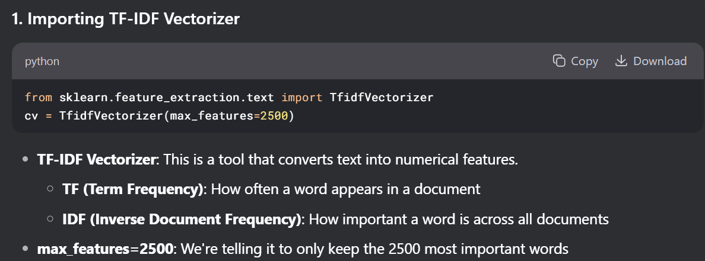
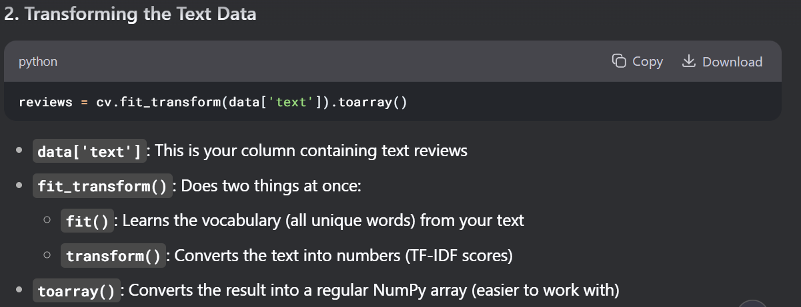

Slide 5
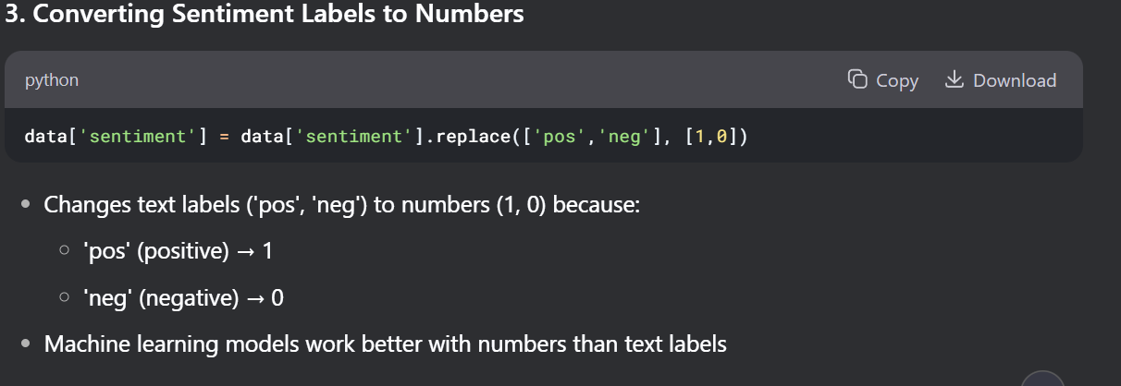
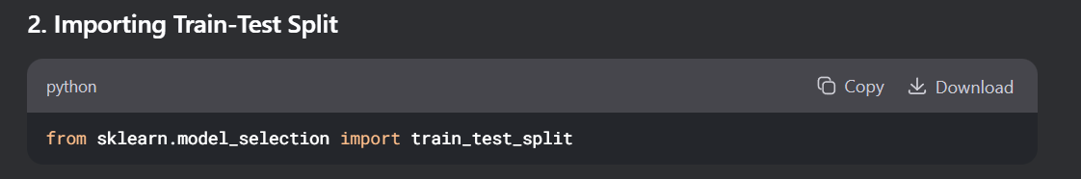

Slide 6
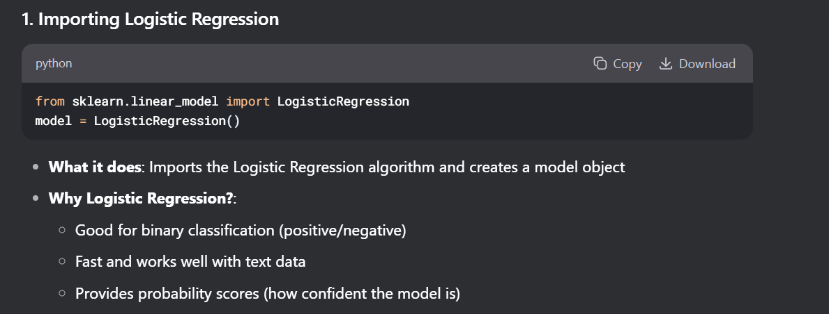
The training section

Slide 7
Feauture is the input
Label is the output
The confusion matrix is : A confusion matrix is a table that helps you understand how well a machine learning model is performing, especially for classification problems (where you're trying to predict categories/classes).
Why is it Used?
Performance Measurement: It shows how often your model is right and wrong
Error Analysis: You can see what kinds of mistakes your model makes
Better than Accuracy: Simple accuracy ("90% correct") doesn't show where mistakes happen

Slide 8
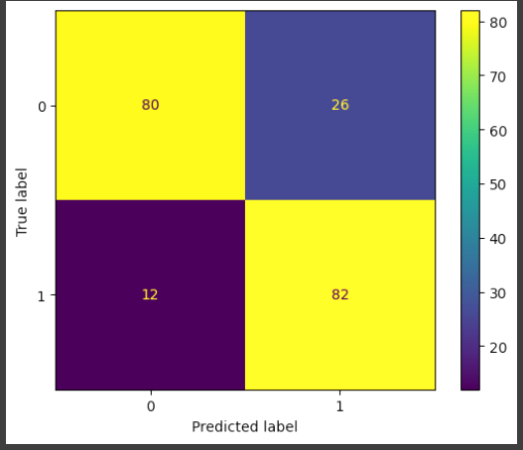
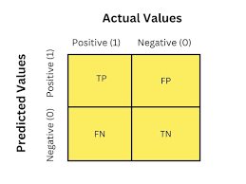
1 for the positive feelings 0 for the negative feelings
80 times class 0 was correctly predicted as 0 (true negatives)
26 times class 0 was incorrectly predicted as 1 (false positives)
12 times class 1 was incorrectly predicted as 0 (false negatives)
82 times class 1 was correctly predicted as 1 (true positives)

Slide 9
Pickle to save the file and the training streamlit to publish the cod e

